Slide 1

DATA BASE OF Debugshala
Presenters:
Arpit Choudhary
Hemant Singh
Vishal Malviya

Slide 2
Title
DebugShala Database Project
DebugShala Institute's database is meticulously designed to manage crucial information for effective educational delivery. With tables for Institute details, Admin roles, Faculty information, Course offerings, and Student records, our database ensures seamless communication and streamlined operations. Leveraging relational structures and robust queries, we enable personalized learning experiences and efficient administrative processes.

Slide 3
The Database Project for DebugShala serves several important purposes and fulfills various needs within the educational institution:
Centralized Information Management:
Centralizes essential institute data.
Ensures data consistency and accessibility.
Manages administrative, faculty, course, and student records efficiently.
Efficient Administrative Processes:
Streamlines course management and enrollment.
Facilitates faculty assignment and communication.
Improves overall administrative workflow.
Enhanced Communication:
Enables efficient sharing of information.
Enhances the learning environment.
Personalized Learning Experience:

Slide 4
Facilitating seamless communication between stakeholders, such as students and Instructors involves creating an environment where information flows smoothly, interactions are timely, and collaboration is efficient.
Clear Communication Channels:
Establish clear and accessible communication channels, such as email, messaging platforms, and dedicated communication tools within the institute's database system.
Regular Updates and Announcements:
Use communication channels to provide regular updates, announcements, and information related to courses, events, administrative matters, and institute policies.
Training and Support:
Offer training and support to stakeholders on using communication tools effectively. Provide guidelines, best practices, and resources to help stakeholders communicate efficiently and professionally.

Slide 5
1. Student Table
Field | Type | Null | Key | Default | Extra
Id | Int | no | Pri | NULL | Auto_increment
name | Varchar(25) | no |  | NULL
email | Varchar(30) | no | Uni | NULL
Description:
ID : Registration number of the Students(1 ,PRIMARY KEY).
Name: students name is in this column (hemant).
Email: Email address of the institute (example@gmail.com).

Slide 6
2. Instructors Table
Field | Type | Null | Key | Default | Extra
Id | Int | no | Pri | NULL | Auto_increment
name | Varchar(30) | no |  | NULL
email | Varchar(30) | no | Uni | NULL
Description:
id : Id of instructor(1,2,3 Primary Key)
Name: Name of the Instructor(ex. Tarun, albin ).
Email: Email address of the institute (example@gmail.com).

Slide 7
3. Courses Table
Field | Type | Null | Key | Default | Extra
Id | Int | no | Pri | NULL | Auto_increment
Title | Varchar(30) | no |  | NULL
Instructor_id | int | Yes | Mul | NULL
Description:
ID: Unique identifier for each Course.(Primary Key)
Title: Name of course (my sql).
Instructor_ID : Instructor id of the teacher(1 ,Foreign KEY).

Slide 8
4. Enrollments Table
Field | Type | Null | Key | Default | Extra
Id | Int | no | Pri | NULL | Auto_increment
Student_id | int | yes | Mul | NULL
Course_id | int | yes | Mul | NULL
Description:
Enroll_id: Unique identifier for each Enroll.(Primary Key)
Student_ID : Student id for each Students(1 ,Foreign KEY).
Course_ID : Course id for each course(1 ,Foreign KEY).

Slide 9
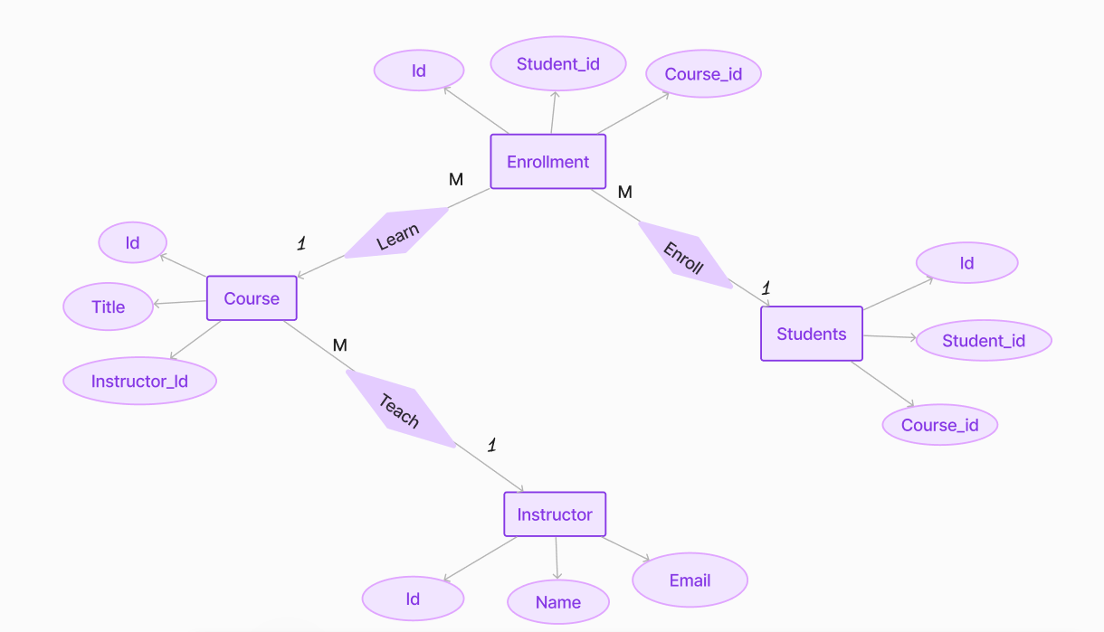
Entity Relation Digram

Slide 10
Conclusion:
our database project for DebugShala aims to revolutionize information management, streamline administrative processes, enhance communication, and provide personalized learning experiences.
By leveraging technology and data-driven strategies, we are committed to ensuring the success and growth of our students, faculty, and administrative staff.

Slide 11

Thank you for your time and attention today. We appreciate the opportunity to share our institute's database project with you.

